Slide 1
Project 1: Webscraping
Rimsky Ho
FTDS Feb 2023

Slide 2

Project outline
Webscraping via Beautiful Soup (bs4), Selenium, or API, with Python as the medium
Scraping Reddit using its API
Tabulating obtained data and presenting it in an organised manner

Slide 3

Aims
Using Reddit’s API, to scrape data off the r/sports subreddit
To provide insight into the popularity of sports among a Western audience
Giving a comparison between the top sports as well as identifying outliers

Slide 4
Business Value
Helping investors decide which sport to invest in, in the form of sponsorships and advertisements
Aiding aspiring athletes in deciding which career to embark on

Slide 5
Data Collection
The r/sports subreddit of Reddit
Using the PRAW module for Reddit’s API
Collecting the top posts of the subreddit, further categorised by:
Post title
Upvotes
Total comments
Date created
Flair
Url
Tabulating with pandas, visualising with seaborn

Slide 6
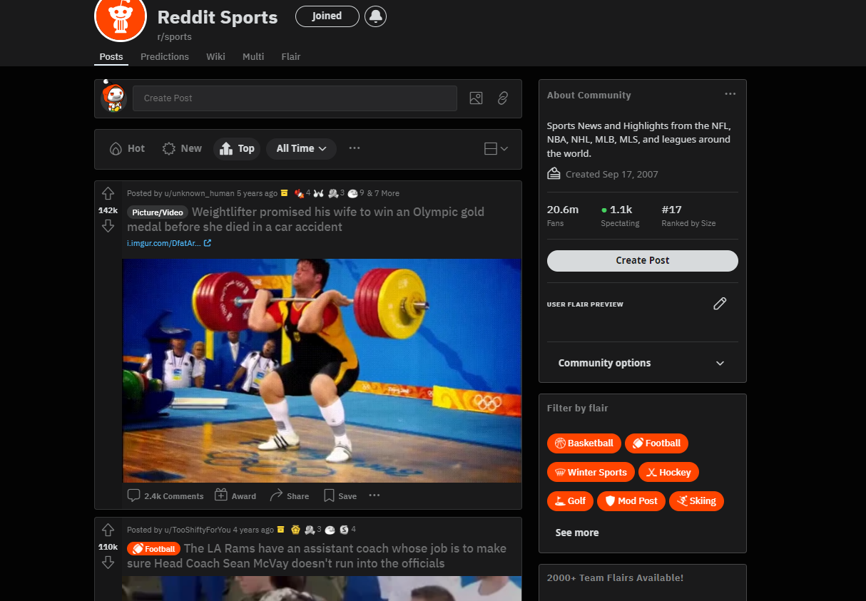
What the r/sports subreddit looks like

Slide 7
Data Preprocessing
Converting from UNIX time
Cleaning up flair titles (for example: turning the flair “:soccer: Soccer” into just “Soccer”)

Slide 8
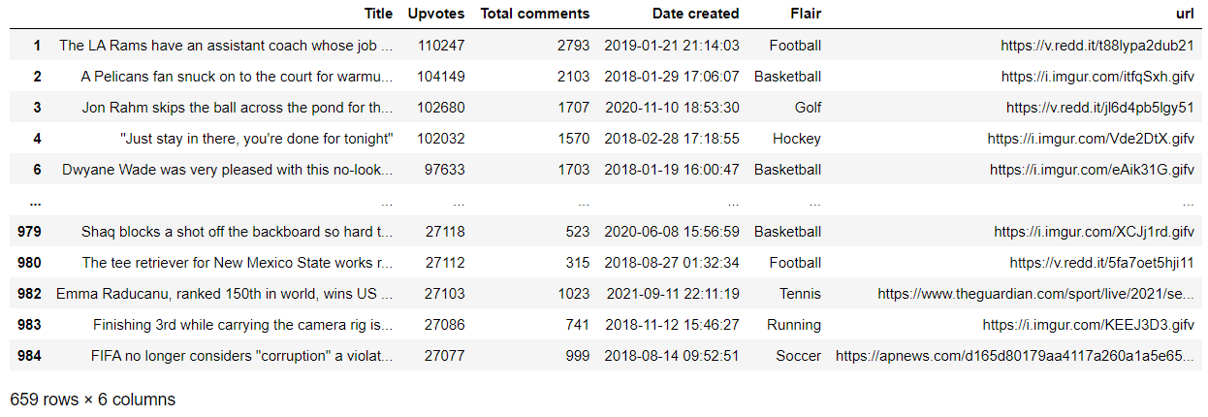
Dataframe (after being cleaned)

Slide 9
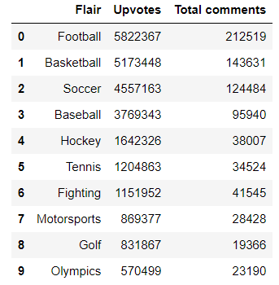
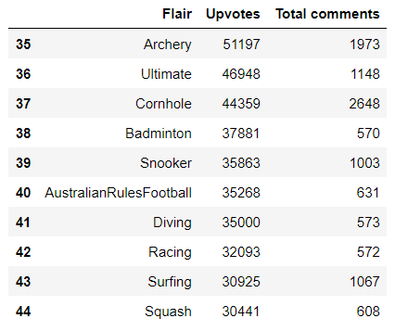
Top 10 most and Top 10 least upvoted Flairs

Slide 10
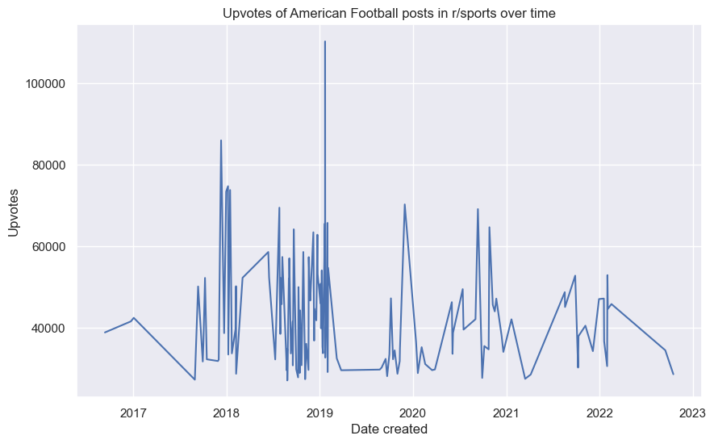
Figure 1

Slide 11
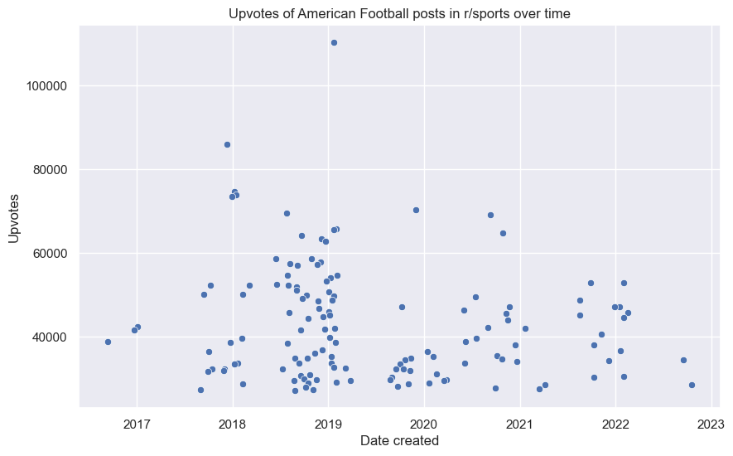
Figure 2

Slide 12
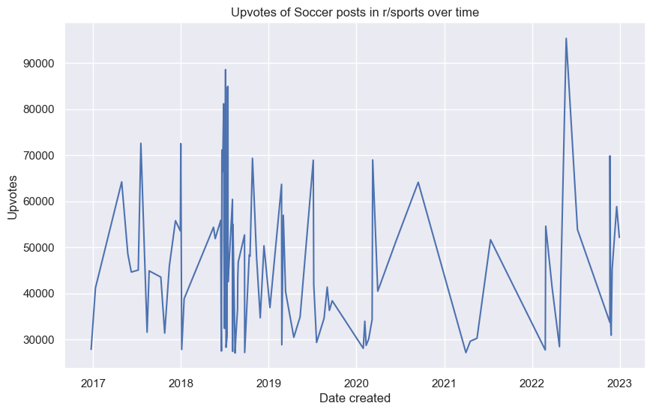
Figure 3

Slide 13
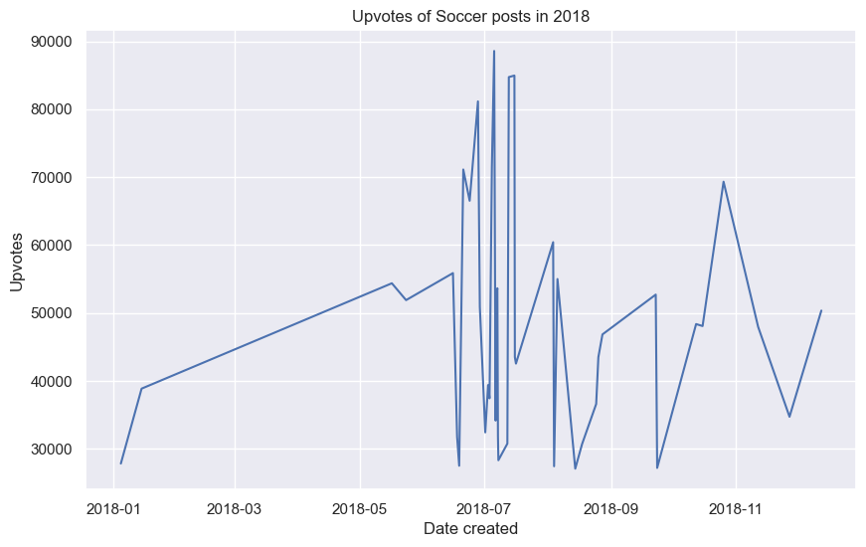
Figure 4

Slide 14
Figure 3

Slide 15
Insight Analysis
Top 5 most popular sports:
American Football
Basketball
Soccer
Baseball
Hockey
Top 5 least popular sports:
Squash
Surfing
Racing
Diving
Australian Rules Football
Popularity may overlap with important events, some sports more than others

Slide 16
Challenge and Limitations
PRAW by itself is limited to fetching only 1000 submissions per subreddit
Not all subreddits have organised and/or informative flairs
Limited to a Western (primarily American) audience
Reddit user base not necessarily reflective of the general population

Slide 17
Conclusion, and next steps
Stakeholders may find it more lucrative to invest in the most popular sports, although there is very fierce competition
For some sports like soccer, popularity peaks during their biggest events
Finding ways to bypass the 1000 post scraping limit
For inclusion of a more globally representative data set, other sites should be scraped too
Television viewership numbers may be a better indicator

Slide 18
The End!
Thanks for watching!

